Slide 1
A Grand Unified Theory of Software
Vinod Dinakaran
BarcampBangalore XII

Slide 2
A Grand Unified Theory of Software
Towards
Vinod Dinakaran
BarcampBangalore XII

Slide 3
..so I had a 92-slide deck prepared…

Slide 4
… and this was slide 92…
… so this is more like a progress report than a finished product…
..but you can help finish it!
GUTSE
WIP
GUTS
WIP
YOUR THEORY

Slide 5
..so I figured this session would work better as a discussion than a monologue ☺

Slide 6
What I’d like to talk about..
What I mean by “A Theory of software”
Why we need such a thing
A pretty good Grand Theory of Software Engineering I found on Google
My own ideas for a Grand Theory of Software
Discuss these ideas

Slide 7
I’ll talk till…
What I mean by “A Theory of software”
Why we need such a thing
A pretty good Grand Theory of Software Engineering I found on Google
My own ideas for a Grand Theory of Software
Discuss these ideas

Slide 8
It’ll be GREAT if we can get till…
What I mean by “A Theory of software”
Why we need such a thing
A pretty good Grand Theory of Software Engineering I found on Google
My own ideas for a Grand Theory of Software
Discuss these ideas

Slide 9
It’ll be AWESOME if we can get till…
What I mean by “A Theory of software”
Why we need such a thing
A pretty good Grand Theory of Software Engineering I found on Google
My own ideas for a Grand Theory of Software
Discuss these ideas

Slide 10
So what does “Theory of Software” mean?

Slide 11

Theorem proving
Code Verification
Theoretical /
Academic
Way(s) of thinking
Useful models
Common Lang
Sensible Axioms
Derivable Laws
Vocab

Slide 12

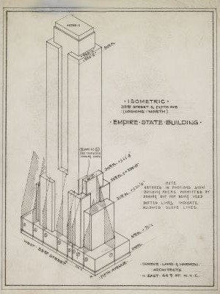
IRL
Emp St Bldg Its model

Slide 13
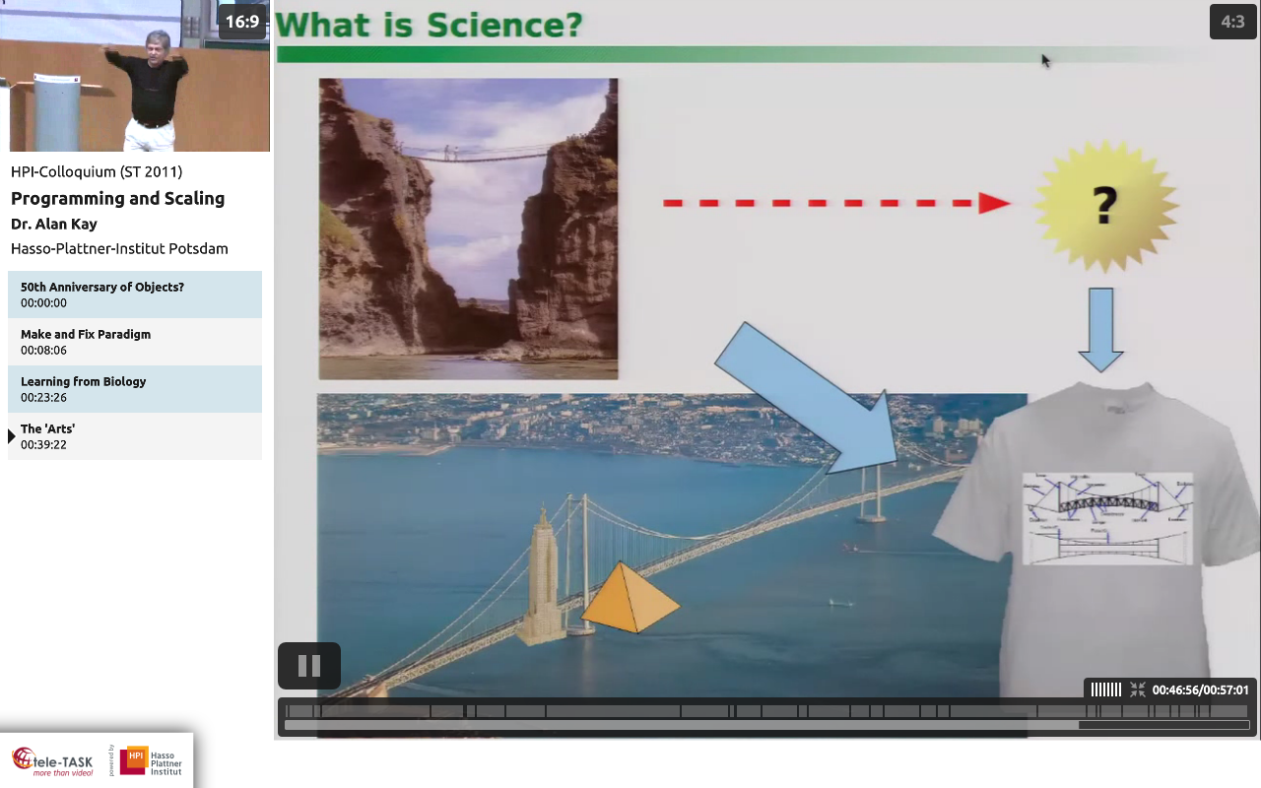

Slide 14
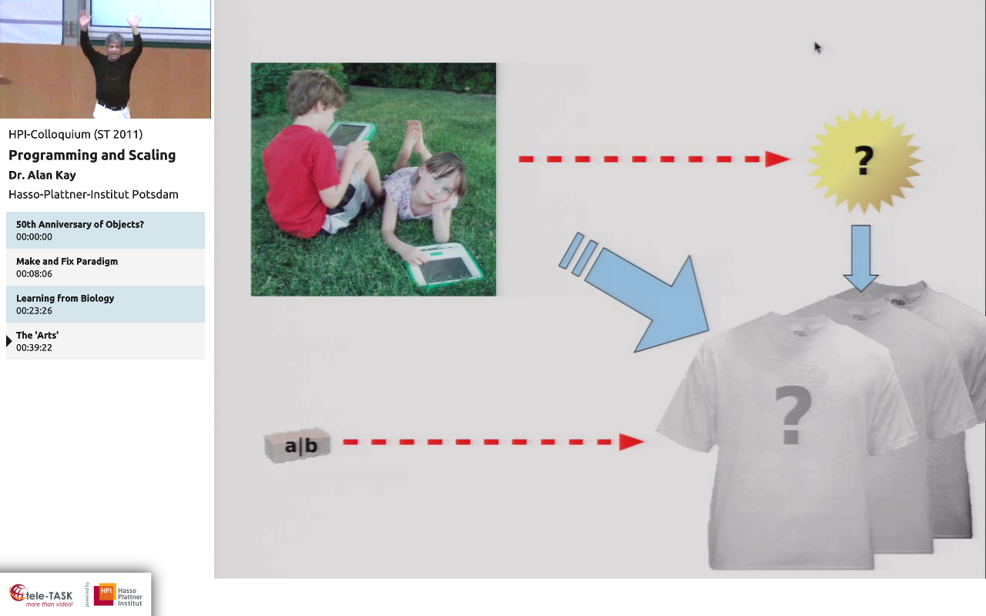
What can we print on the T-shirts for software?

Slide 15
We’d print the Theory of Software on T-shirts

Slide 16
Why do we need a “Theory of Software”?

Slide 17
This is software development/engineering today

Slide 18
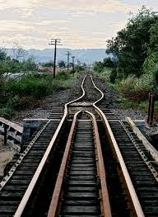
Integration

Slide 19
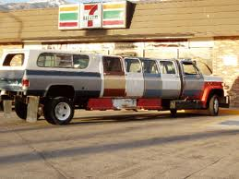
Webapp

Slide 20
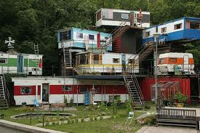
Enterprise App

Slide 21
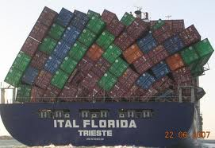
IT Org

Slide 22
3 reasons, therefore

Slide 23
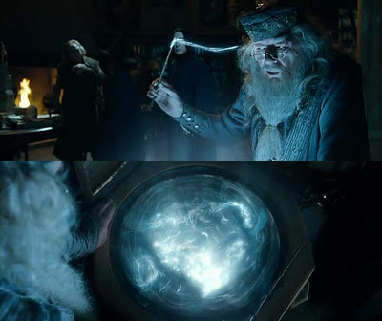
#1: S/w Dev is a lossy process
We need a Pensieve for software for the lost “WHY”s

Slide 24
#2: We no longer software that we built … at least not fully …its that big
Understand

Slide 25
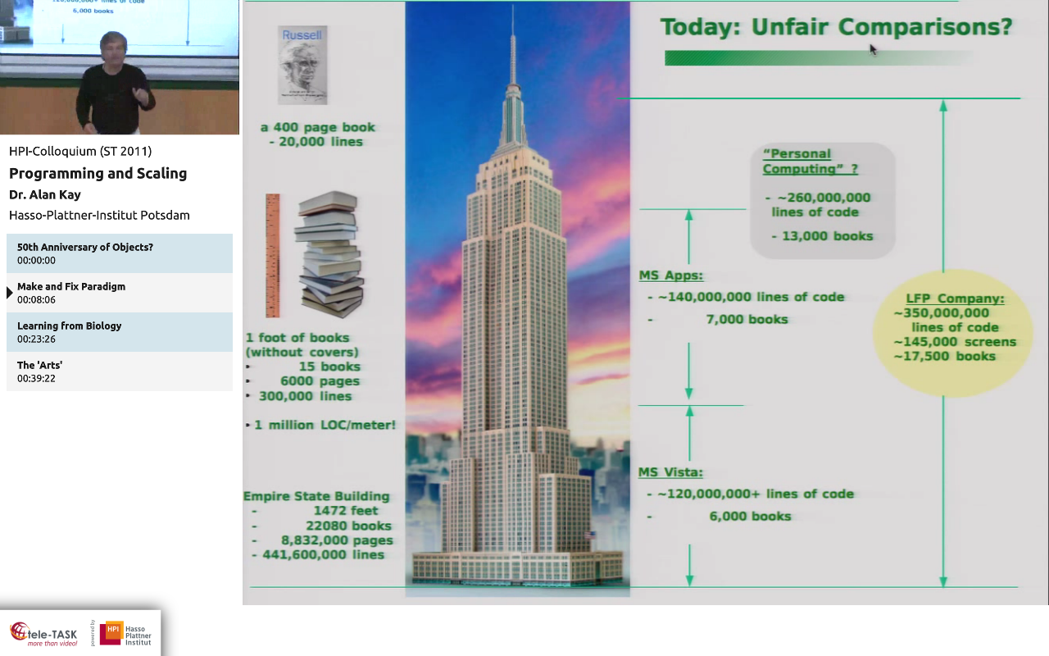

Slide 26
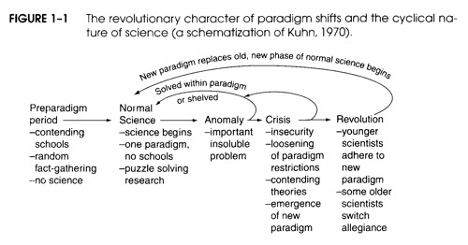

#3: we’re due some Revolution
We are here
We need to be here

Slide 27
As proof I present a lot of
Micro-theories, Idioms, best practices and methodologies

Slide 28
Goto is harmful
Structured programming is good
Object Orientation is good; encapsulate state
Functional programming is good; avoid state
TDD is good; test everything!
Adding manpower to a late project makes it later
The man-month is a dangerous and fallacious myth, for it implies that man and machine are interchangeable
You ship your organization, i.e., your code has the same shape as your org structure
Release early, release often (startups)
Use old, proven technology (Mars rover)
Hardware doubles in performance every 18 months
1 program
n programs
1-n devs
1 pm
n pm’s
1 org
n orgs
the world

Slide 29
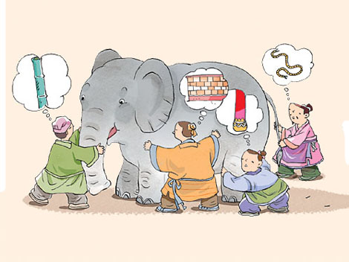
Remind you of something?

Slide 30
So what’s required of a “Theory of Software”?

Slide 31
Once built, with the ToS we could…
Use the model as a blueprint to build software
One model can build many “instances” of software – same or similar
One model will allow reasoning about all such instances
There would be “Universal Software Laws”
…pigs will fly…unicorns everywhere…

Slide 32
So like other Physical theories
One paradigm => Unified
Simple
No schools => Consistent
Defined scope
Puzzle Solving => Definition & Explanation
Research => Falsifiable

Slide 33
They’re not the same, tho…
Real World | Software world
“Out there” | Inside our heads
Real, unchangeable limits | Limited only by our imagination
Objective (well, mostly) | Subjective

Slide 34
So unlike other Physical theories
Any ToS should :
Directly represent man and the subjectivity that comes with it
Allow for how the human mind works and model it
Model human organizations and human + machine combinations
Model software; its structure and behavior

Slide 35
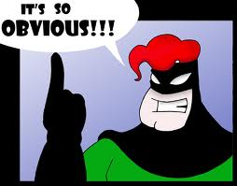
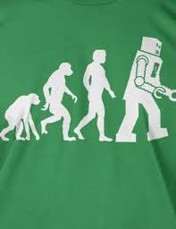
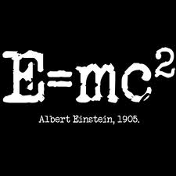

Finally, like any body of science, it should have…
Axioms: Givens, “Taken for granted”s, universal truths
Theories: Assumptions based on the axioms
Laws: Proven theories
Application of the Science

Slide 36
Two candidates: GUTSE & GUTS

Slide 37
GUTSE and GUTS: a comparison
Feature | GUTSE | GUTS
Unified, simple | Y | *
Consistent | Y | *
Defined Scope | Y | Y
Vast explanation capacity | Y | N
Falsifiable | Y | Y
Models humans | Y | Y
Models human Orgs | Y | N
Models human+m/c combos | Y | N
Models software | Y | Y
Has axioms | Y | Y
Has Theorems | N | *
Has Laws | N | *
Has applications | Y* | N

Slide 38
… and so we come full circle…
… so this is more like a progress report than a finished product…
..but you can help finish it!
GUTSE
WIP
GUTS
WIP
YOUR THEORY

Slide 39
Where do we go from here?
GUTSE
GUTS
Discussion

Slide 40
Questions?

Slide 41
GUTSE: Axioms

Slide 42
Q: What do we do when we write software?

Slide 43


A: We solve problems using machines

Slide 44
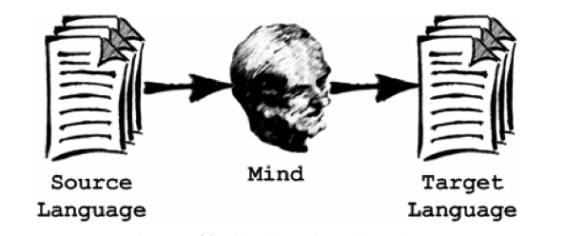
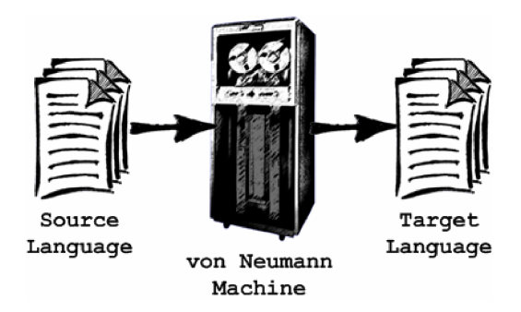
Actually…. We solve problems & encode the solutions using so that machines can run them instead of us
Coded Solution
Running Solution
Problem

Slide 45

Problem
Solution
Encoded Solution
Solution to problem

Slide 46
Axiom
All Software Development is therefore a Grand translation exercise

Slide 47


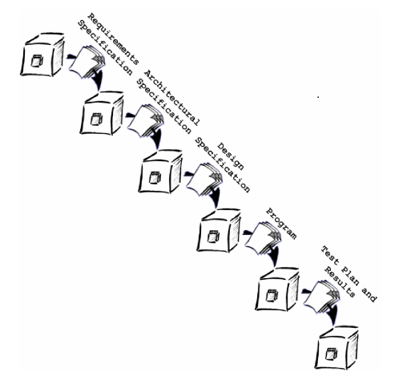
…translation of what? To what?

Slide 48


A string of symbols
Generally, A composition of building blocks
(aka Composition units)
E.g.:
Pascal: "procedure begin .... end".
whole thing is the spec, each identifier is a CU
English: "This is a sentence".
Words are CUs, sentence is the spec;
Sentences are CUs, Para is the spec;
and so forth
A set of specifications, constrained by the kind of CUs allowed to be in them
E.g.:
Java, Fortran, Assembly
Equally: Requirements Spec, Design Doc
UML
Logs

Slide 50
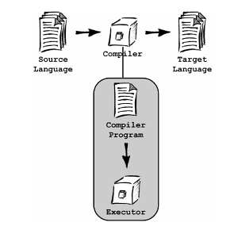
Special case: the Executor

Slide 51
Axiom
All Software Engineering can be expressed in terms of transformers and specifications

Slide 52
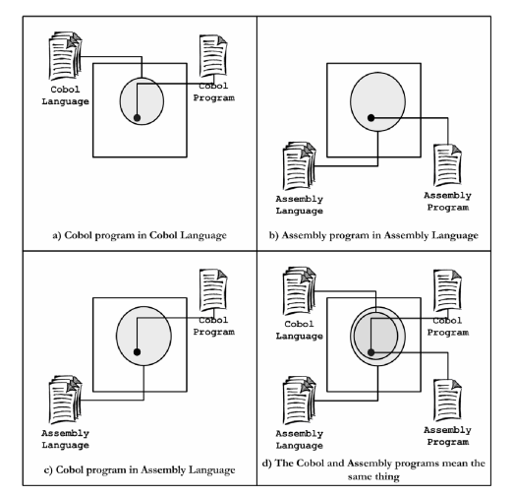
But it cant all be rote transforms, right?
A: Semantic Mappings (yes, they’re Venn Diagrams)

Slide 53
Axiom
Mapping a language to another (via a transformer) defines it in terms of the other language; thereby giving it meaning.

Slide 54
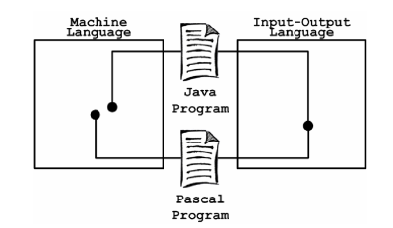
Sem-nastics: The Semantic Domain
This is a Semantic Domain because both programs mean the same in this domain

Slide 55
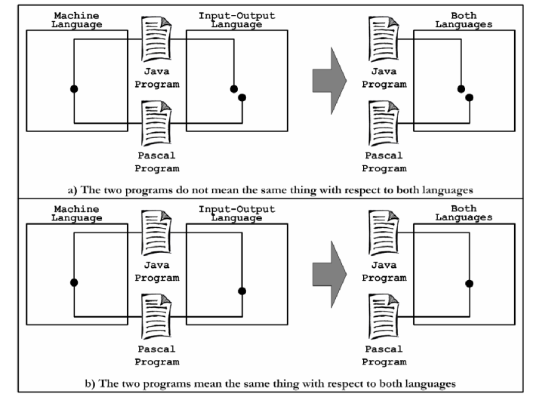
More Sem-nastics
SD
SD
SD

Slide 56
Axiom
A Semantic Domain is where semantic relations become syntactic. If two specs’ translation into an SD are syntactically equivalent, then they are also semantically equivalent.

Slide 57
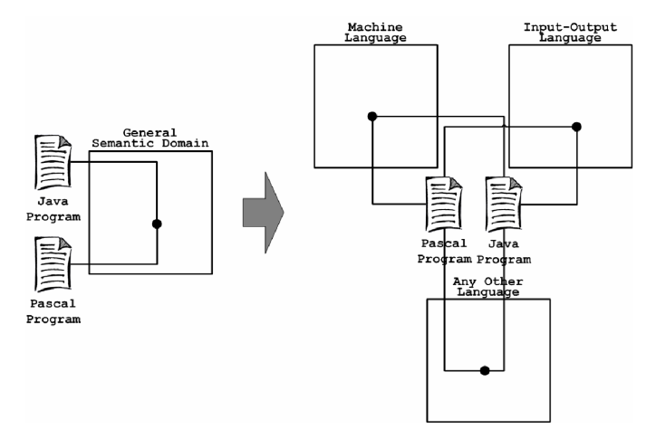
General Semantic Domain

Slide 58
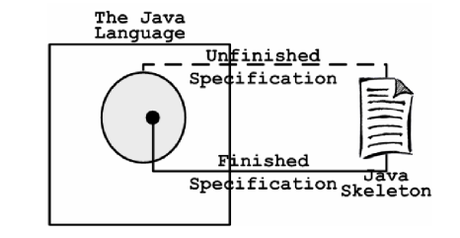
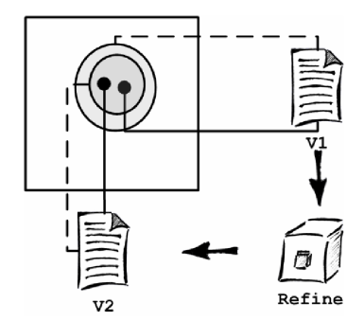
More Sem-nastics

Slide 59
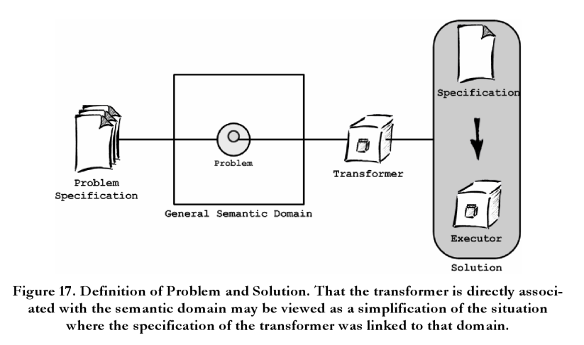
Problem Solving: GUTSE-style

Slide 60
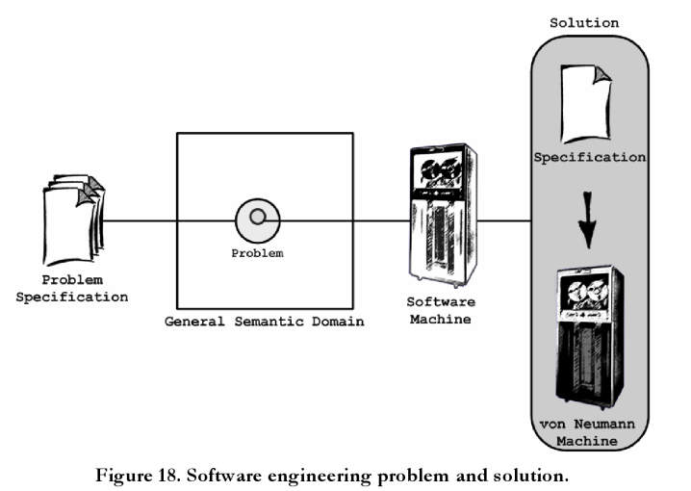
Sw Engg: GUTSE-style

Slide 61
We still need to define the machine and the mind a little bit better so that we can reason about their behavior

Slide 62
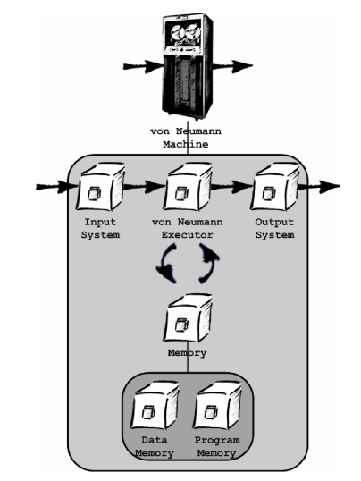
The model m/c: a Von Neumann m/c

Slide 63
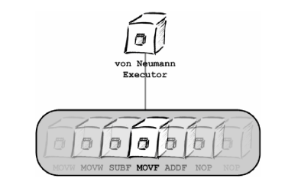
The vNM executor

Slide 64
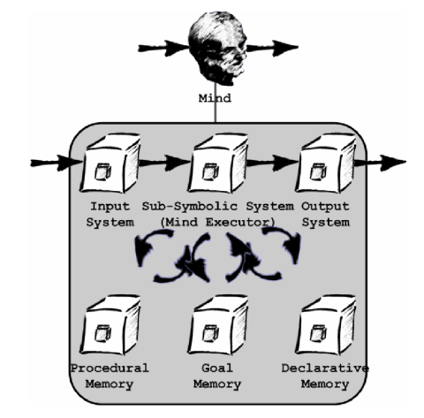
The model mind: ACT-R
Requirements:
Explain and predict problem solving
Explain and predict HUMAN problem solving
Without ignoring our understanding and learning difficulties
Concrete and operationalized.

Slide 65
ACT-R Demo

Slide 66
ACT-R Demo
E.g.: if Goal Memory has:
=goal>
isa ADDITION
n1=three
n2=four
ans=nil

Slide 67
ACT-R Demo
… and Procedural Memory has:
Add-nos
=goal>
isa ADDITION
n1=three
n2=four
ans=nil
=fact>
isa ADD-FACT
addend1=num1
addend2=num2
sum=sum
==>
=goal>
ans=sum

Slide 68
ACT-R Demo
and we indeed have a fact in Declarative Memory that asserts:
=fact3+4>
isa ADD-FACT
addend1=three
addend2=four
sum=seven
... then the mind will output
seven
… as the answer.

Slide 69
ACT-R Demo
This is a simple example, but more complex ones are:
- reasoning by counting
- retrieval from memory
- retrieval from input system (e.g., by reading a book)

Slide 70
GUTSE: Theories

Slide 71
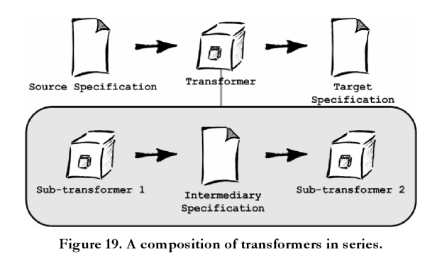
Composing transformers

Slide 72
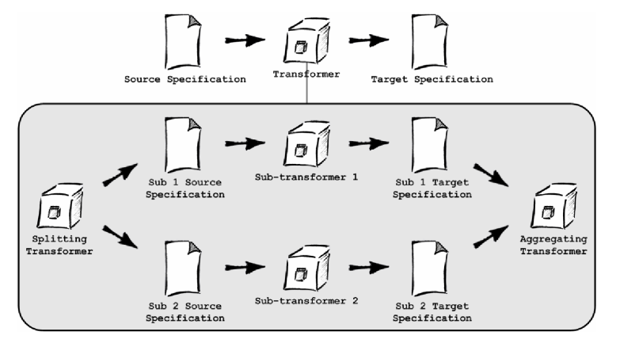
Composing Transformers

Slide 73
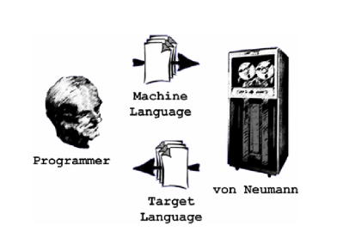
Man + m/c

Slide 74
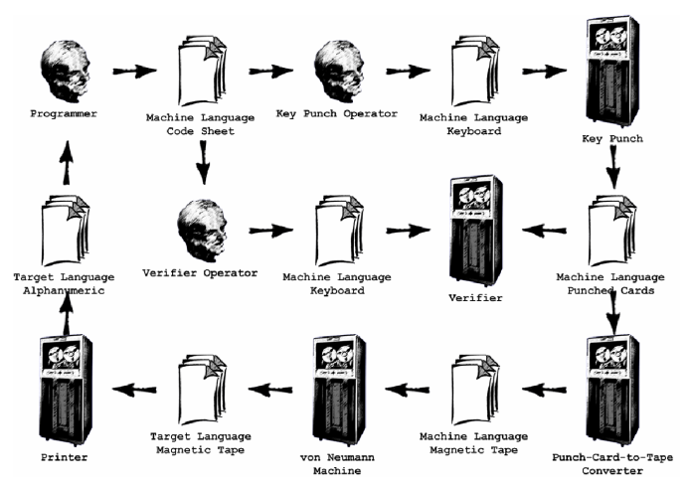
Man + m/c : Circa 1970s

Slide 75
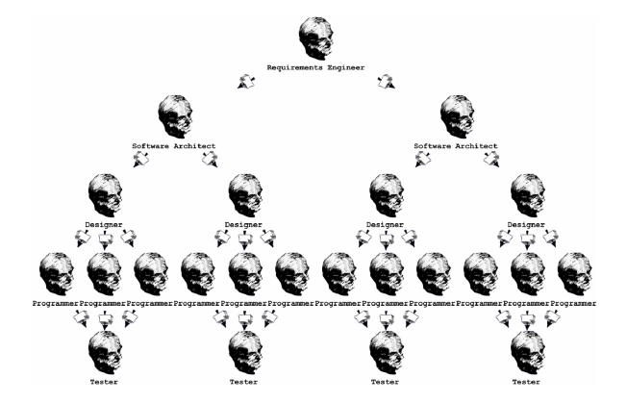
Organization: Waterfall

Slide 76
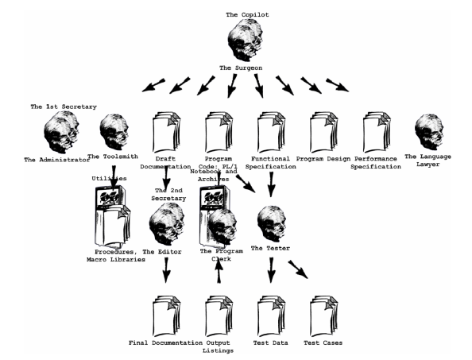
Organization: MMM

Slide 77
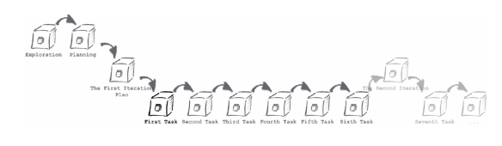
Organization: XP

Slide 78
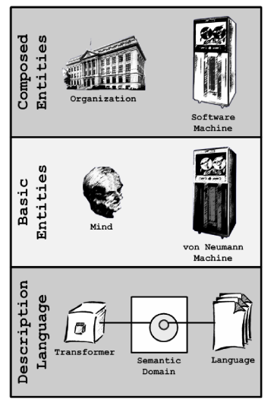
GUTSE: 50k view

Slide 79
GUTSE: Laws

Slide 80
Meta Law: no law can be stated without qualification wrt a specific SD

Slide 81
GUTSE: Application of Science

Slide 82
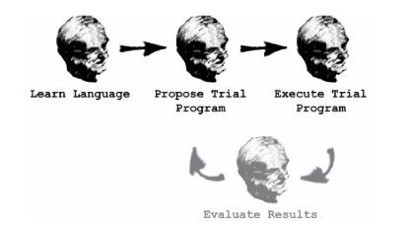
Tour de Force: Assembly vs. HLL
Q:Which is better from a Programmer’s POV?
A: Let’s model the process of learning the language, writing a trial program and then executing a real program by implementing a Bubble Sort in both
C /Assembly SD
C /Assembly Execution State Space
Lists of Numbers SD

Slide 83

… then let’s replace the human with ACT-R and see how it behaves
C /Assembly SD
C /Assembly Execution State Space
Lists of Numbers SD

Slide 84
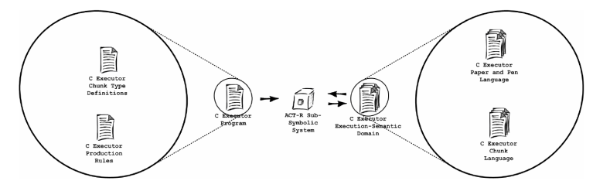
Step 0: Simulate a language in ACT-R
The Assembly machine’s ACT-R setup is essentially the same

Slide 85
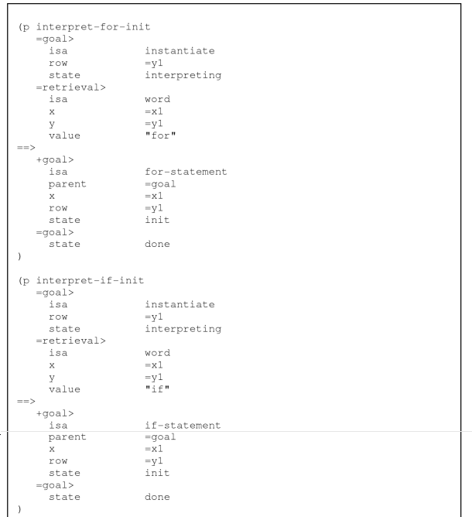
Sample Rule from Sim

Slide 86
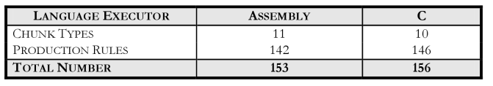
Step 1: Learn the languages

Slide 87
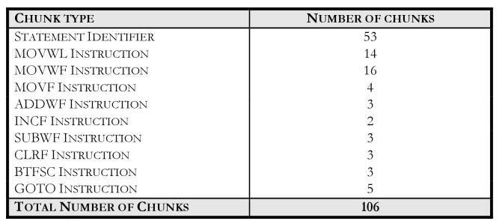
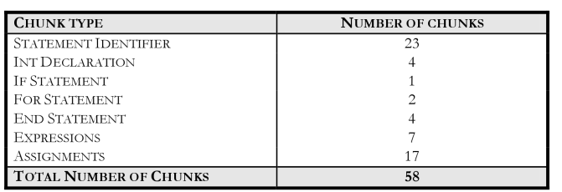
Step 2: Learn the Sort program
Assembly
C

Slide 88
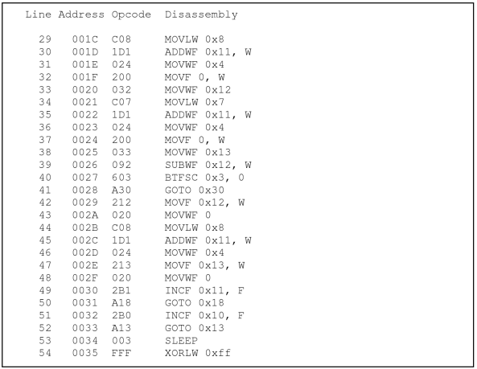
Bubble Sort in Assembly

Slide 89
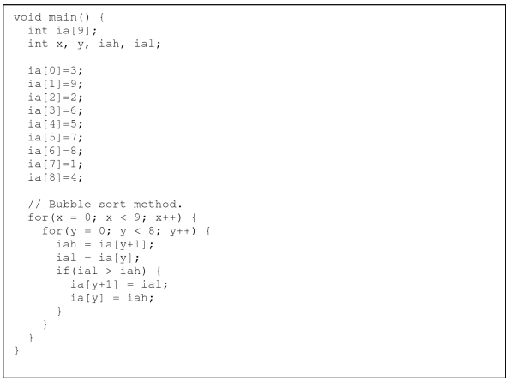
Bubble Sort in C

Slide 90
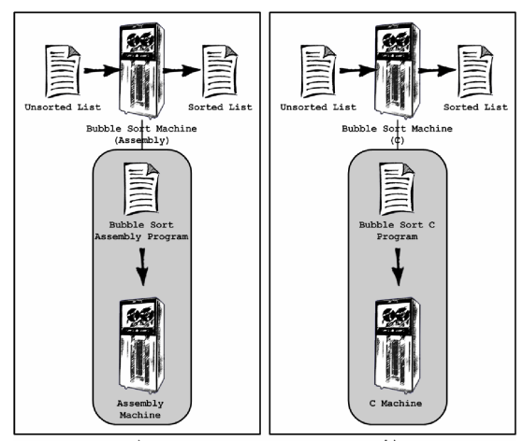
Step 3: Simulate run of s/w bubble sort m/c’s written in Assembly & C

Slide 91
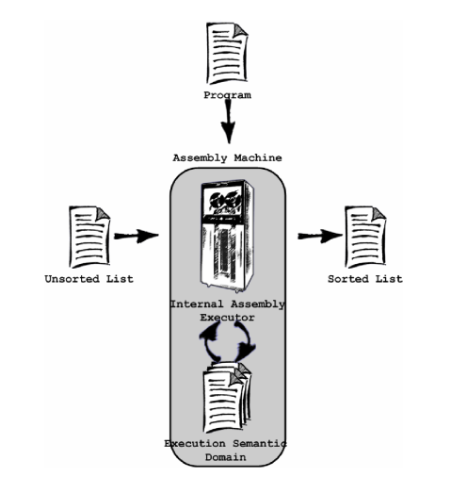
Bubble Sort m/c: Internals
The C machine’s internal view is essentially the same

Slide 92
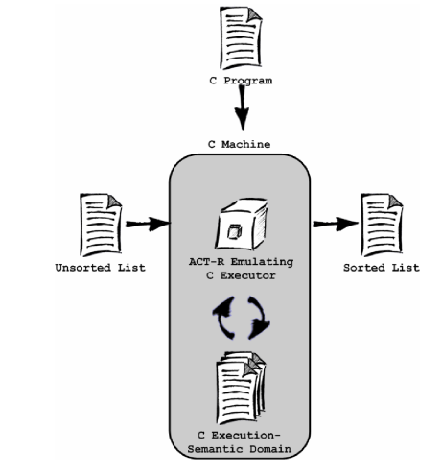
Bubble Sort m/c: Simulated Internals

Slide 93
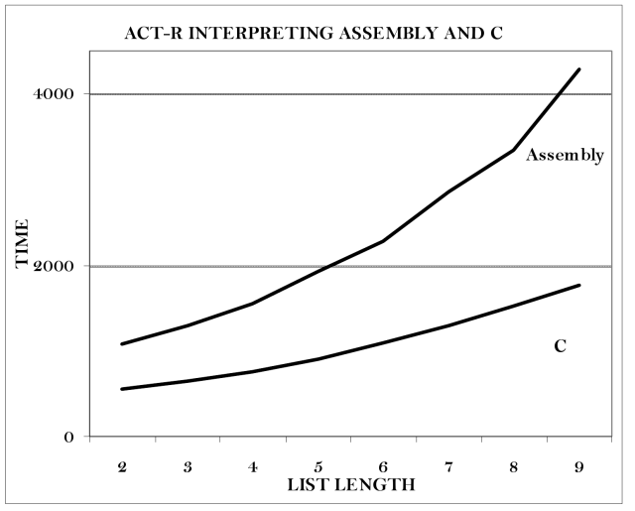
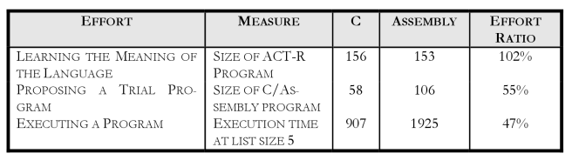
Actual run results
~2X effort for Assembly
Overall, C wins

Slide 94
GUTS

Slide 95




A brief tangent before we start
“Sw FEM” post
+ GUTS
Waitaminnit…
…GUTSE!

Slide 96

Start with the “how to read..” node (see links)

Slide 97
Links
Ref | Link
Alan Kay’s Talk | http://www.tele-task.de/archive/video/flash/14029/
“FEM analysis on code” blog post | http://tt2n.blogspot.com/2009/06/fem-like-analysis-on-code.html
GUTS | https://github.com/vinodkd/guts
GUTSE | http://books.google.com/books/about/The_Grand_Unified_Theory_of_Software_Eng.html?id=TLcceL3NEiMC

Slide 98
Thank You
Vinod.dinakaran@gmail.com
+vinod.dinakaran
@vinod_dinakaran
tt2n.blogspot.com

